Slide 1
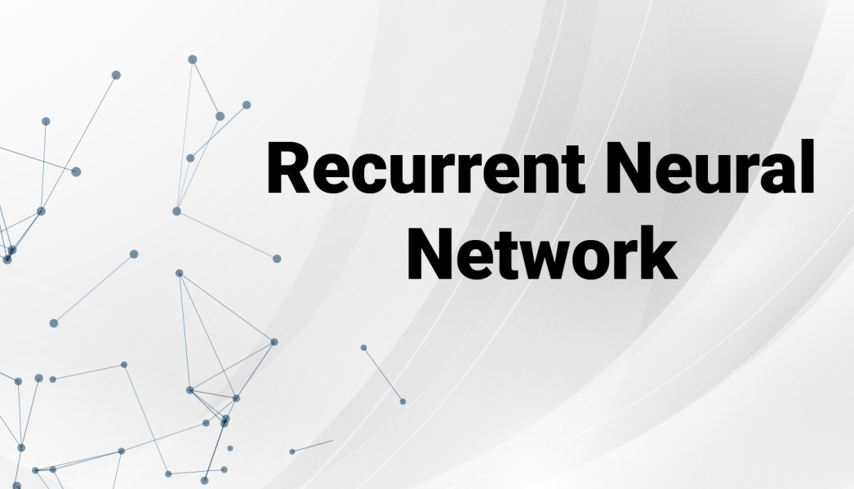

Slide 2
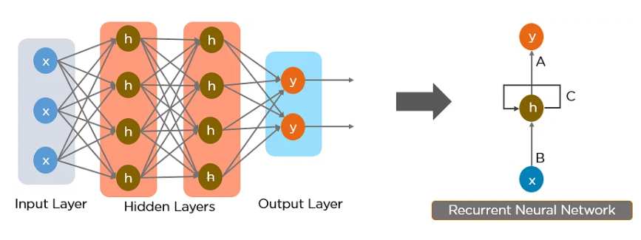
Recurrent Neural Network (RNN)
An artificial neural network adapted to work for time series data or data that involves sequences.
Uses a Hidden Layer that remembers specific information about a sequence
RNN has a Memory that stores all information about the calculations.
Formed from Feed-forward Networks

Slide 3
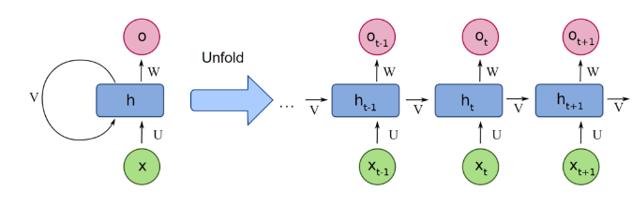
Recurrent Neural Network (RNN)
Uses the same weights for each element of the sequence
Need to inform about the previous inputs before evaluating the result
Comparing that result to the expected value will give us an error
Propagating the error back through the same path will adjust the variables.

Slide 4
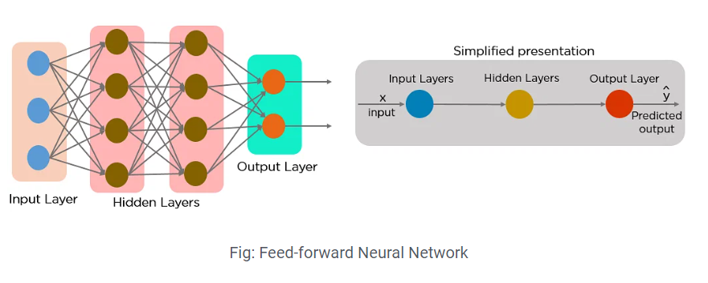
Why Recurrent Neural Networks?
RNN were created because there were a few issues in the feed-forward neural network
Cannot handle sequential data
Considers only the current input
Cannot memorize previous inputs
Loss of neighborhood information.
Does not have any loops or circles.

Slide 5
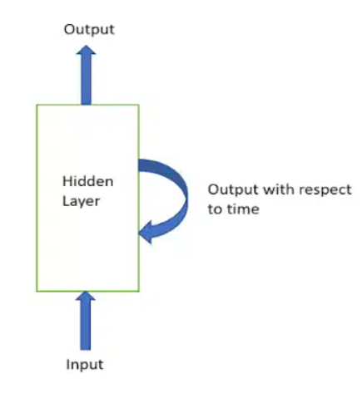
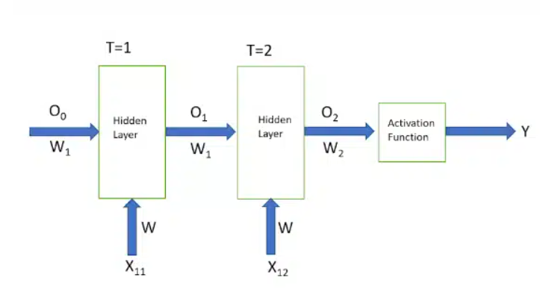
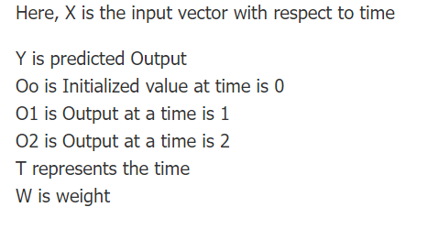
Architecture of RNN

Slide 6
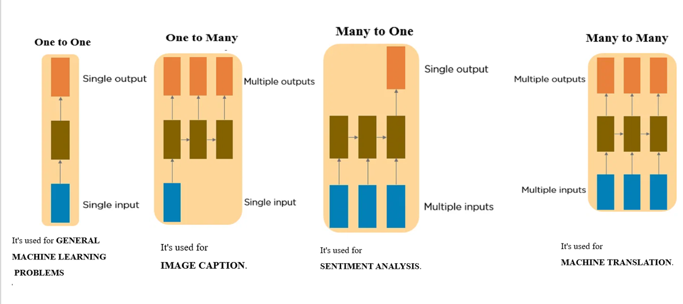
Types of Recurrent Neural Networks

Slide 7
Steps for training a RNN
Initial input is sent with same weight and activation function.
Current state calculated by using current input & previous state output
Current state Xt becomes Xt-1 for second time step.
Keeps on repeating for all the steps
Final step calculated by current state of final state and all other previous steps.
An error is generated by calculating the difference between the actual output and generated output
by RNN model.
Final step is when the process of back propagation occurs
Yi
Ot
f
xt
Recurrance formula ht = fw( ht-1, xt )
ht= new hidden state
fw= some functions of parameter w
ht-1= old state
xt= input vector at some time spent
t=1
t=2
t=2
t=4
O0
O1
O2
O3
O4
f
W_xh
W_xh
W_xh
W_xh
W_xh
Y^i
O1=f(Xi1w_hh + O0W_xh) O3= f(Xi3W_hh + O2W_xh) O2=f(Xi2w_hh + O1W_xh) O4= f(Xi4W_hh + O3W_xh)
W_hh
W_hh
W_hh
W_hh
xi1
xi2
xi3
xi4

Slide 8
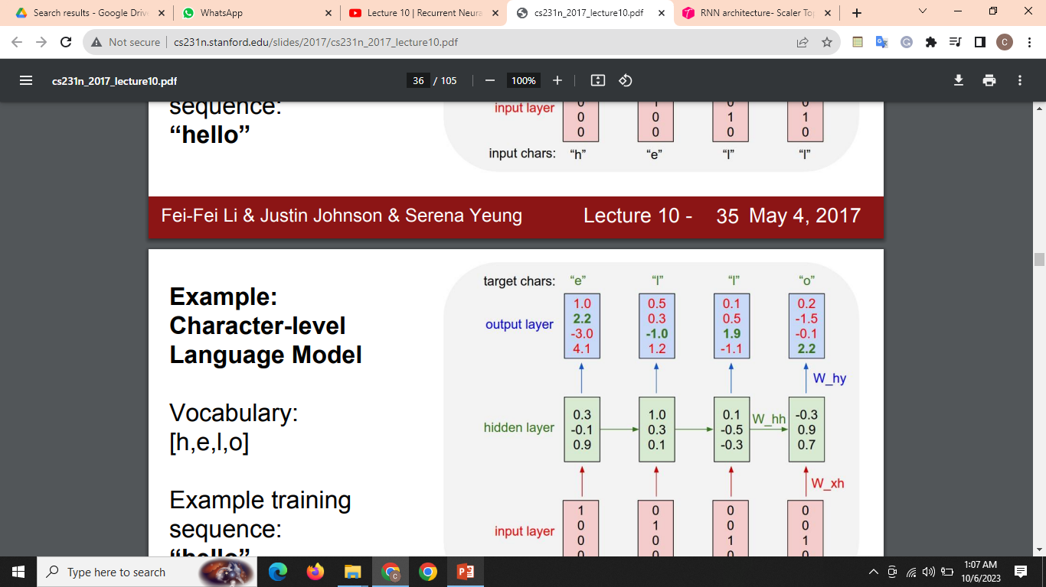
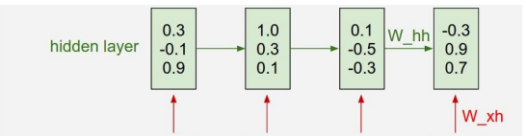


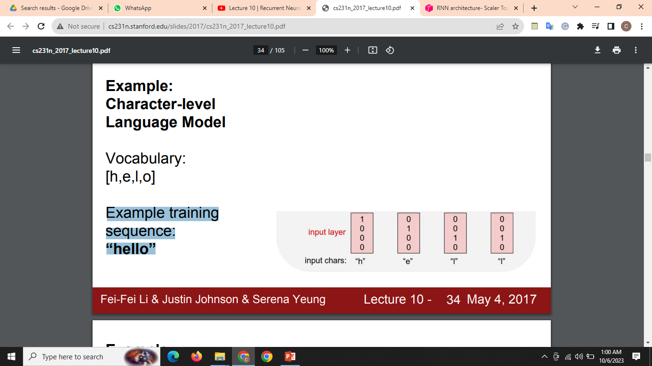
Example: Character-level Language Model
Vocabulary: [h,e,l,o]
Example training sequence: “hello”

Slide 9
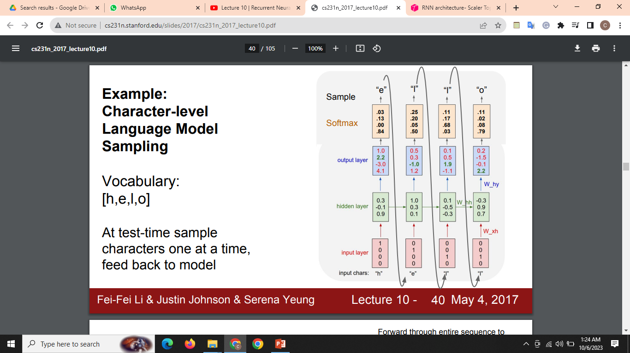
Continued…
Vocabulary: [h,e,l,o]
At test-time sample characters
one at a time,
feed back to model

Slide 10
Back Propagatipon
To reduce lose function derivative of y^i ∂L/∂y^i By Chain rule W_xh is dependent on y^i, ∂L/∂y^i
∂L/∂w_xh= (∂L/∂y^i * ∂y^i/∂w_xh)
Weight Updation, W_hh_new= W_xh – ∂L/∂w_xh
Weight Updation W_xh w.r.t O3 in Backward Propagation at time t3
By Chain Rule O4 is dependent on W_hh, y^i
dependent on O4, loss is dependent on y^I, ∂L/∂y^ ∂L/∂w_xh= (∂L/∂y^i * ∂y^i/∂O4 * ∂O4/∂w_hh)
W_new_hh=W_xh – (∂L/∂y^i * ∂y^i/∂O4 * ∂O4/∂w_hh)
t=1
t=2
t=2
t=4
O0
O1
O2
O3
O4
f
W_xh
W_xh
W_xh
W_xh
W_xh
Y^i
W_hh
W_hh
W_hh
W_hh
xi1
xi2
xi2
xi4
Loss=y - y^i

Slide 11
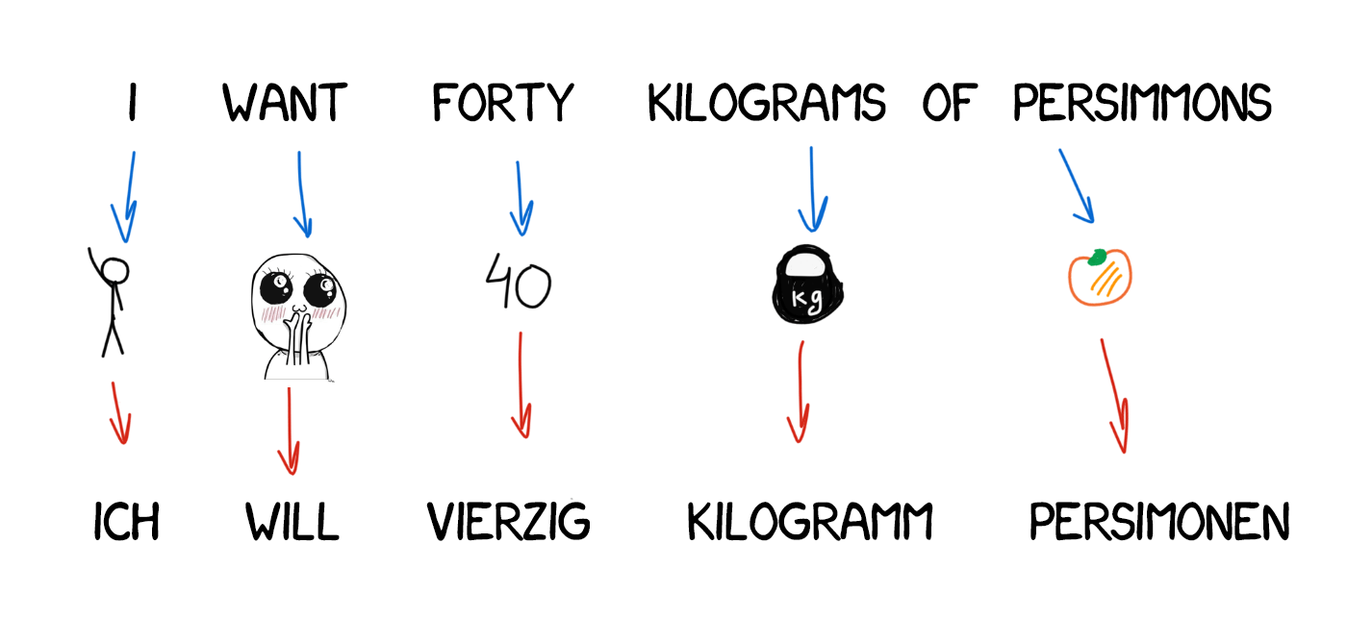
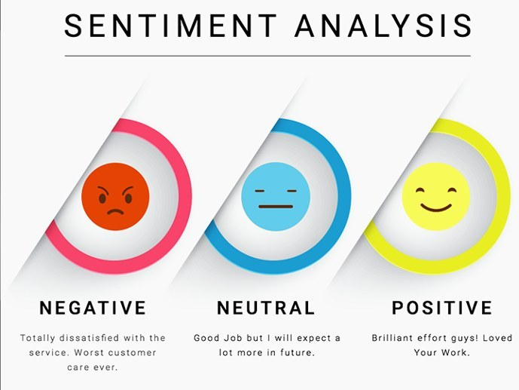
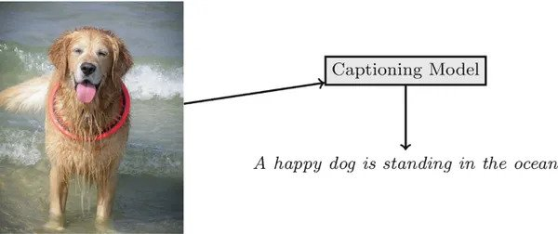

Application
Machine Translation | Text Classification
Captioning Images | Recognition of Speech

Slide 12
Advantage
Disadvantage
Computation is slow.
Training can be difficult.
Using of relu or tanh as activation functions can bevery difficult to process sequences that are very long.
Prone to problems such as exploding and gradient vanishing.
Input of any length.
To remember each information throughout the time which is very helpful in any time series predictor.
Even if the input size is larger, the model size does not increase.
Weights shared across the time steps.

Slide 13


Vanishing & Exploding Gradient

Slide 14
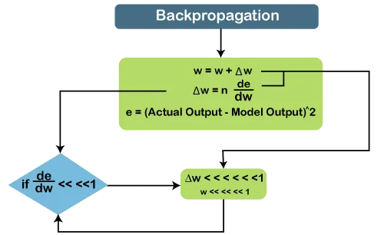
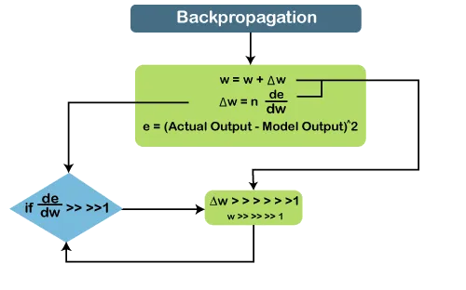
How to identify a vanishing or exploding gradients problem?
Vanishing
Weights of earlier layers can become 0.
Training stops after a few iterations.
Exploding
Weights become unexpectedly large.
Gradient value for error persists over 1.0.

Slide 15
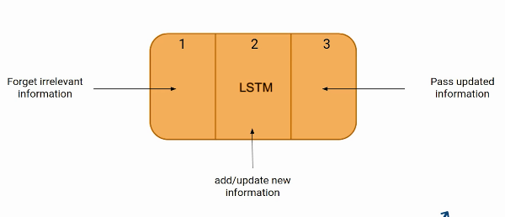
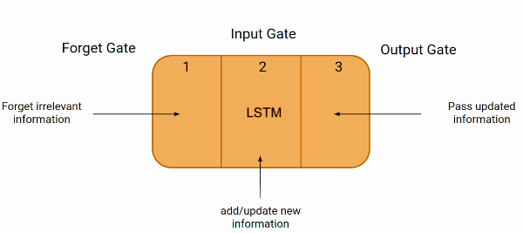
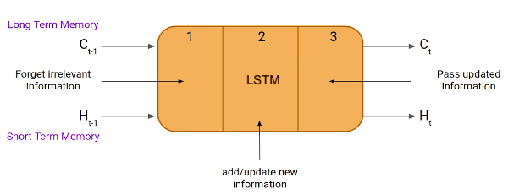
LSTM

Slide 16
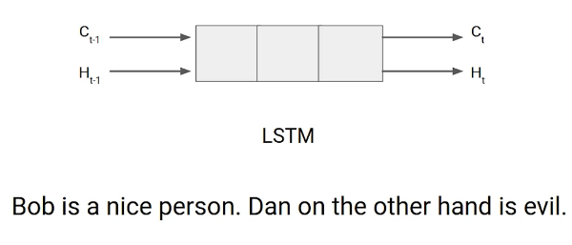
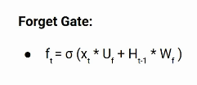
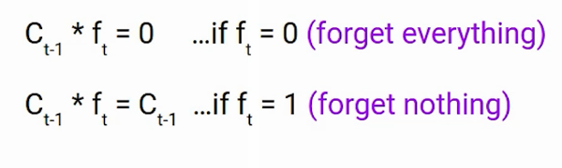
Working Process of LSTM
Forget Gate
X_{t}: Input to the current timestamp
U_{f}: Weight associated with the input
H_{t-1}: The Hidden state of the previous timestamp
W_{f}: It is the weight matrix associated with the hidden state

Slide 17
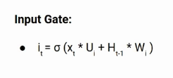




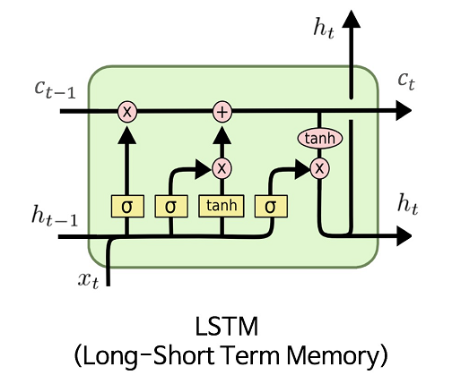
Continued
“Bob knows swimming. He told me over the phone
that he had served the navy for four long years.”
Bob single-handedly fought the enemy and died for
his country. For his contributions, brave______.”

Slide 18
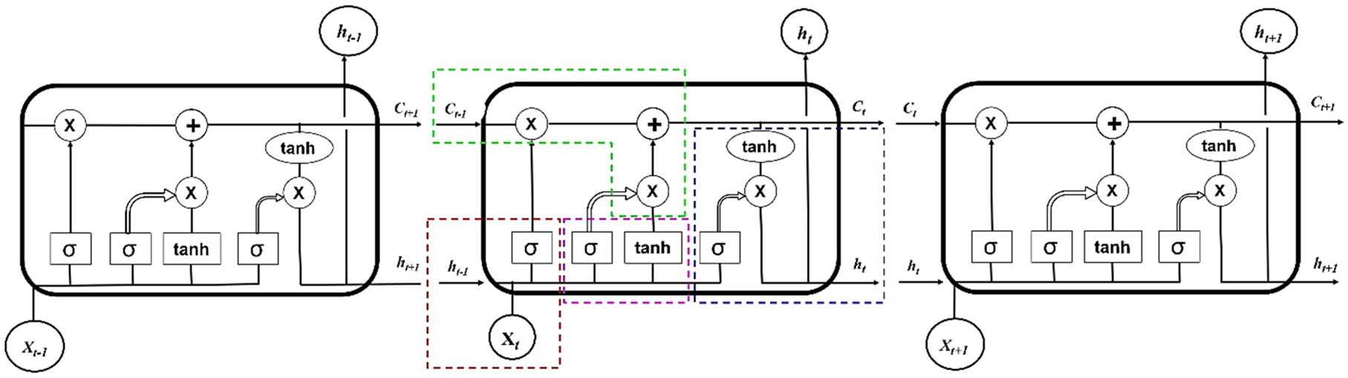
Continued…

Slide 19
Gradient Clipping
Clipping – by – value
🡪A minimum clip value and a maximum clip value.
g ← ∂C/∂W
‖g‖ ≥ max_threshold or ‖g‖ ≤ min_threshold
g ← threshold (accordingly)
Clipping – by – norm
Clip the gradients by multiplying the unit vector of the gradients with the threshold.
g ← ∂C/∂W
if ‖g‖ ≥ threshold then
g ← threshold * g/‖g‖

Slide 20
Thank You

